Slide 1



QUBAA MUSLIM SCHOOL
ROLES OF CRISIS TEAM MEMBERS

Slide 2
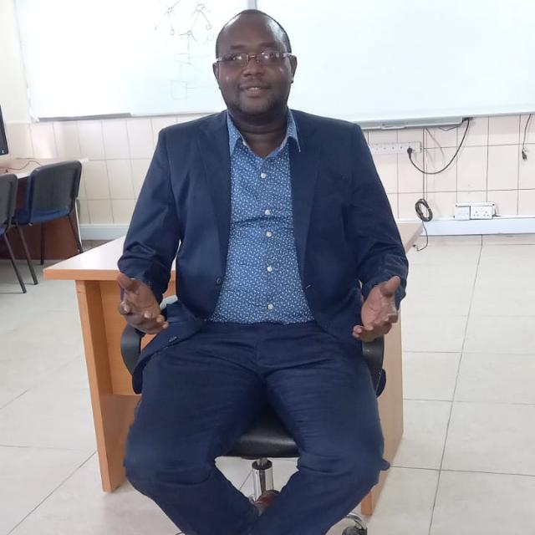

1
Crisis team chairperson
Leonard Mbalu
Convenes scheduled and emergency team meetings, oversees both broad and specific team functions, ensures that the required resources are available to each team member for assigned duties, and communicates with the district-level team. Is often an administrator or designee.
2
Assistant chairperson
Antony Kengera
Assists the crisis team chair with all functions and substitutes for the chair in the chair's absence.

Slide 3
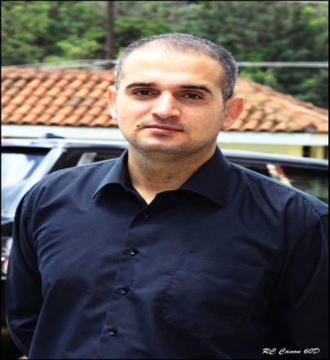

3
School counsellor
Talip ozdemir
Develops mechanisms for on going training of crisis team members and other school staff and identifies and establishes liaisons with community resources for staff and student counseling. At the time of a crisis, determines the extent of counseling services needed, mobilizes community resources, and oversees the mental health services provided to students. Must have appropriate counseling and mental health skills and experience.
4
Staff notification coordinator
Anastacia wuaw
Establishes, coordinates, and initiates the telephone tree when school is not in session to contact the crisis team and general school staff, including itinerant, part-time, and paraprofessional staff. Also establishes a plan to rapidly disseminate relevant information to all staff during regular school hours.

Slide 4


5
Communications coordinator
Fatma Mohamed
Conducts all direct in-house communications, screens incoming calls, and maintains a log of telephone calls related to the crisis event. Helps the staff notification coordinator develop a notification protocol for a crisis event that occurs during the school day.
Media spokesman/ coordinator
6
Swaleh Salim
Contacts the media; prepares statements to disseminate to staff, students, parents, and the community; and maintains on going contact with police, emergency services, hospital representatives, and the district office to keep information current. Handles all media requests for information and responds after coordinating a response with the media coordinator for the district-level team.

Slide 5

7
Crowd management coordinator
Mamun Abubakar
In collaboration with local police, mosque imam and fire departments, develops and implements plans for crowd management and movement during crises, including any required evacuation plans and security measures. Crowd management plans must anticipate many scenarios, including the need to cordon off areas to preserve physical evidence or to manage increased vehicular and pedestrian traffic. Because of the possibility of actual threats to the physical safety of students, crowd management plans must provide for safe and organized movement of students in a way that minimizes the risk of harm to them under various threats, such as sniper fire.

Slide 6

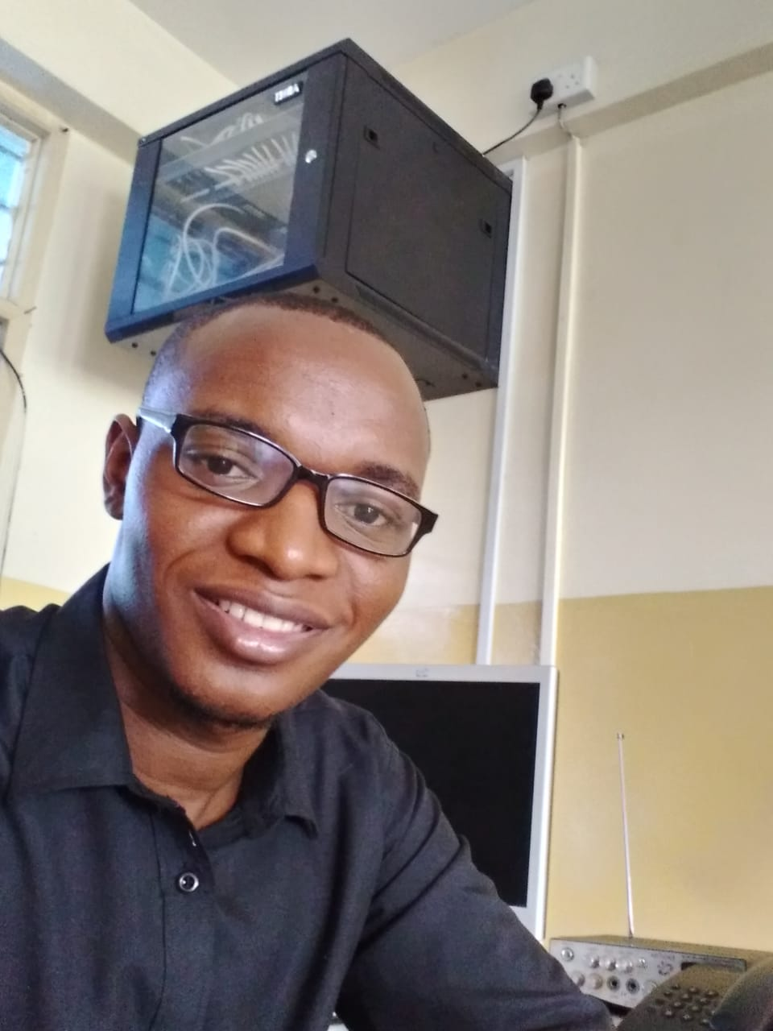
8
School Nurse or Health Technician
Nurse Aisha Mohamed
Administers first aid, triage and locates emergency card information for injured student
9
Campus Supervisor
Thilkadir Juma
Coordinates immediate security and protections. Roams , Hostels, Dining, , Classes and campus to help identify students in need.

Slide 7


Food supplier
10
Abdurrahman Bawazir
The school's food service is done over the canteen. Abdurrahman is very sensitive about healthy, economical and hygienic food to the students. He serves in accordance with the school's principles.
11
Mosque Man(Imam)
Ali Abdalla
The mosque imam preaches on the religious discipline and morality of the students in his five-time prayers, both on Friday sermon and in other sermons times, but he also tells in his sermons how students should have good character. In the event of any crisis, it will be assisted in terms of religion.

Slide 8

12
Makupa Police Department
Police Officers in school systems have diverse roles. school-based officers' assignments in schools may vary depending on the school district, but there are common responsibilities such as mentoring, teaching, creating partnerships, building relationships, and ensuring school safety. Time spent at the school also varies – hours assigned can be full-time, part-time, or on an on-call basis only. Officers often play a blended role in schools, depending on the unique characteristics of the school.
The most important things for school-based officers to know are what their role is and how to best engage with students, parents, administrators, teachers, and staff while on campus.

Slide 9
Roles | Name | Office Phone | Cell Phone | e-mail
Chair Person | Leonard Mbalu | 0722836683 | 0722170380 | leondonye@gmail.com
Assistant Chairperson | Antony Kengera | 0722836683 | 0704416507
School Counsellor | Talip Ozdemir | 0722836683 | 0713553100 | careercounseling@qubaamuslim.sc.ke
Staff Notification Coordinator | Anastacia Wuaw | 0722836683 | 0725047349 | anastaciawuaw@gmail.com
Communication Coordinator | Fatma Mohammed | 0722836683 | 0746589900 | fatmafamau66@gmail.com
Media Spokesman | Saleh Salim | 0722836683 | 0712130820 | Swalehsalim28@gmail.com
Crowed Management Coordinator | Abubakar Mamun | 0722836683 | 0720872307
School Nurse/ Health Technician | Aisha Mohamed | 0722836683 | 0700461315 | Aishamohamed001@gmail.com
Campus Supervisor | Tilkadir Juma | 0722836683 | 0792810744 | Thilkahum2@gmail.com
Food supplies | Abdurrahman Bawazir | 0722836683 | 0741029966 | abdurrahmanbwzr@gmail.com
Makupa Police Department | Police officer | 911 | 0722999999 | https:/www.kenyapolice.go.ke

