Slide 1


ADVOCATING
SCHOOL COUNSELOR

Slide 2
Who is school counselor?
As professionals, we are continually answering this question as we advocate for our profession. To promote advocacy, Counselors sometimes feel uncomfortable as they try to show their worth as a school counselor, but advocacy is necessary and will ultimately demonstrate how students are different because of what school counselors do.
Advocating for role a school counselor means stepping out of your realm and into the realm of your stakeholders. Teachers, parents, and administrators how your work aligns with what is important to them.

Slide 3
Advocacy in Defining the Role of the School Counselor
Advocacy is sharing our role with teachers, administrators, school board, legislators and showing them how we can help them to reach our educational goals.
The school counselor’s role remains unclear in many school districts. School counselors’ tasks, expectations and demands vary from district to district and school to school. In many cases, the definition of the school counselor’s role is left to the administrator’s discretion. When faced with questions about their roles and responsibilities, school counselors can refer to One Vision, One Voice resources.

Slide 4
Advocacy’s Impacts
Share vision to guide change
Leadership capable of driving change
Organizational arrangement change
School counselor is thinking systematically by identifying practices that negatively impact students and those that should be replicated or explained
Reaching more students
The school counselor collaborating with other educators can help foster a vision and belief in the development of high aspiration in every child.
The school counselor’s skills in communication interpersonal relationship, problem solving, and conflict resolution can impact the beliefs and attitudes of teachers and administrators regarding widening opportunities for students.

Slide 5
Beneficence – continually seek ways to enhance opportunities for student success.
Nonmaleficence – consider the impact of one’s action or lack of action to determine if potential harm will result.
Loyalty – remain steadfast in efforts to make systemic change for all students.
Justice – look at each individual’s unique needs and be able to justify treating students differently.
Autonomy – empower each and every child to become his or her own advocate
Counselor’s Five Moral Principles

Slide 6

What is advocacy?
Advocacy means communicating to stakeholders what the comprehensive school counseling program is, how it makes a difference, and how it affects the success of all students.

Slide 7

Goal setting
teaching students a process for goals setting and goal achievement is also important. Goal setting can be a crucial skill in the successful student and school counselor toolkit.
As counselors, we are constantly trying to help students make progress academically, socially, behaviorally, and emotionally. We know how necessary it is to use effective techniques to help students set goals, break them into manageable tasks, and track those goals.
our goals for improving our school counseling program and making it the best it can be.
Making students a small group, giving them best counseling for their academic success,
I have to make a Short term goals and long term goal setting for students from from-1 to form-4 until national exam

Slide 8
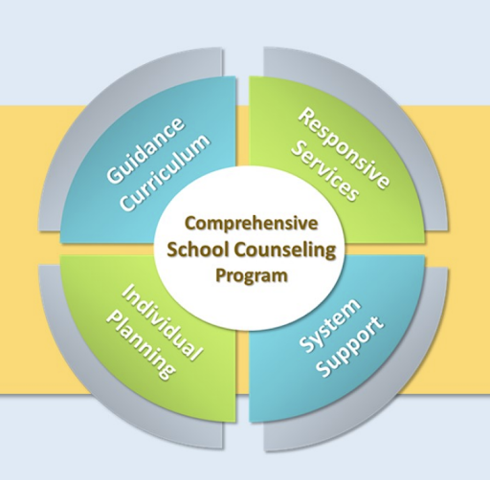
Advocacy for School Counseling Program
Advocacy ensures that stakeholders understand the role of the school counselor and the importance to students of implementing a comprehensive school counseling program
what our learners want and need and the services and supports that our school counseling program can provide.
Students needs proper and healthy counseling program which they can benefit for their career, as a school counselor we provide career assessment, career plan, career choices, career selection, college and universities application etc.

Slide 9
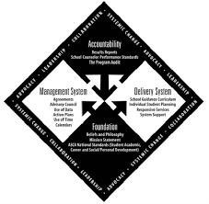
Delivery methods
School counselors deliver a school counseling program in collaboration with students, families, school staff and community stakeholders.
Direct Services With Students
Direct services are face-to-face or virtual interactions between school counselors and students and include the following:
Instruction
Appraisal and Advisement
Counseling
Indirect Services for Students
Indirect services are provided on behalf of students as a result of the school counselors’ interactions with others including:
Consultation
Collaboration
Referrals

Slide 10
Craft message
“I am here everyday to encourage you to continue to provide a full educational experience to the elementary students of the Qubaa High School by continuing to provide quality school counseling by certified professionals.”
“we work for your future”
All students should benefit from counseling service.

Slide 11
Plan Into Action
Now is the time to put all the plans we have made for school counseling services into action.
Short and long term plans, career plans, academic plan, college application plan will be in action after settled all of them

Slide 12
Identify resources and gaps, monitor and adapt the strategy
As the person who provides the counseling service, we choose the resources we will give to the students at the school.
For example : The career assessment.
Because most of students are not aware of this service we provide in school. And most of them need this service,
I made a plan to make assessment to all form-1 students until end of the year.
So when I do every year like this by end of 4 year all student will be done with assessments and minimized all problem they are facing now.

